Slide 1
Pairs Trading: performance of a relative value arbitrage strategy
Evan G. Gatev
William N. Goetzmann
K. Geert Rouwenhorst
Yale School of Management

Slide 2
Statistical “Arbitrage”
Identify a pair of stocks that move in tandem
When they diverge:
  short the higher one
  buy the lower one
Unwind upon convergence

Slide 3
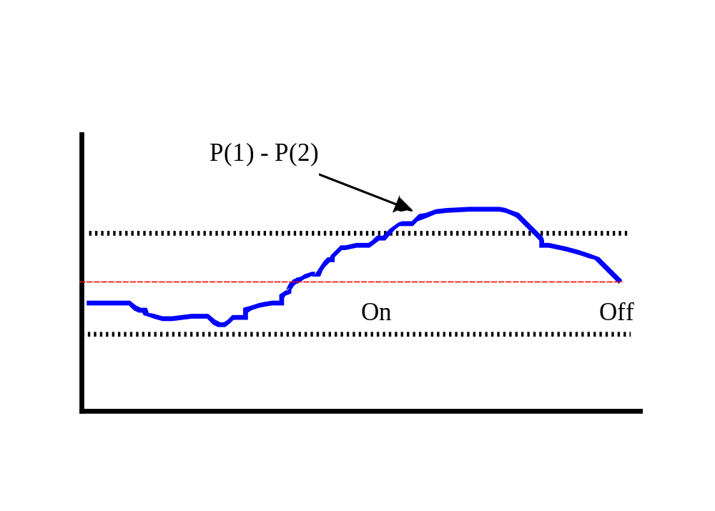
Example

Slide 4
Who does it?
Proprietary trading desks
  Morgan Stanley
  Nunzio Tartaglia - 1980’s
  Other investment banks
Hedge funds (Long-short)
  Cornerstone
  D.E. Shaw?

Slide 5
Economic Rationale
Tartaglia:
  “Human beings don’t like to trade against human nature, which wants to buy stocks after they go up, not down…”
Imperfect markets?
  Over-reaction
  Under-reaction

Slide 6
Relative Pricing
Approximate APT Models
  Long-short “arbitrage in expectations”
  Self-financing
  Eliminate relative mispricing
  Silent on absolute pricing
Mechanisms
  risk-matched portfolios
  risk-matched securities

Slide 7
Law of One Price
Matching state payoffs => Matching prices
Near Matching state payoffs ?=>
  Chen and Knez (1995) market integration
Conditions:
  Errors in states that don’t matter much

Slide 8
Methodology
Two stages:
  1. Pairs Formation
  2. Pairs Trading
Committed Capital
  full period
  when-needed
  no extra leverage

Slide 9
Pairs Formation Period
Match on stock cumulative return index
  Minimize squared price error
  Twelve months of daily prices
Equivalent to matching on state-prices
  Each day is a different state
  Assumes stationarity
  Assumes a year captures all states

Slide 10
Pairs Formation Period
Daily CRSP files
Eliminate stocks that missed a day trading in a year
Cumulative total return index for each stock
Also restrict to same broad industry category: Utilities, Transports, Financials, Industrials

Slide 11
Related Work
“Style Analysis” via clustering algorithm
  Brown and Goetzmann (1997)
Bossaerts (1988)
  Seeking co-integration in price series
Chen and Knez (1995)
  market integration measures
  finding close pricing kernel across two markets

Slide 12
Trading Period
Six-month periods: 1962-1997
  starting a new “trader” each month
  closing all positions at end of each six month
How many pairs to use?
  5, 20 and 20 after first 100, then all pairs under distance metric

Slide 13
Trading Period
Open at 2  (historical  over leading year)
Close upon convergence, or end of six-month period
Same-day vs. wait one day to control bid-ask effect

Slide 14
Excess Return Computation
Weakly positive payoff inside the six-month interval and:
Positive or negative payoff on last day
No “marking to market”
Ignore financing issues
Excess return on pair = sum of payoffs over interval

Slide 15
Excess Return
Return on committed capital
  Sum of payoffs over all pairs in period/# pairs
  Allow $1/per pair
Return on employed capital
  All $1/pair used

Slide 16
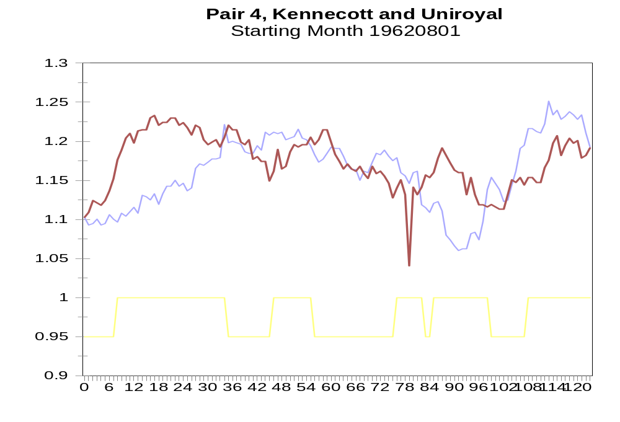

Slide 17
Results for Same Day Trading
Portfolio of 5 and 20 best pairs earn an average of 6% per six month period.
Average size of stocks in pairs: 3rd to 4th decile
Utilities predominate

Slide 18
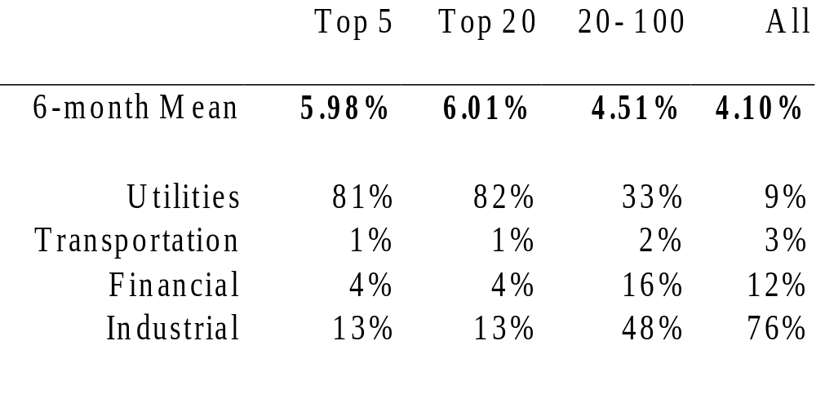
Same-Day Trading Performance

Slide 19
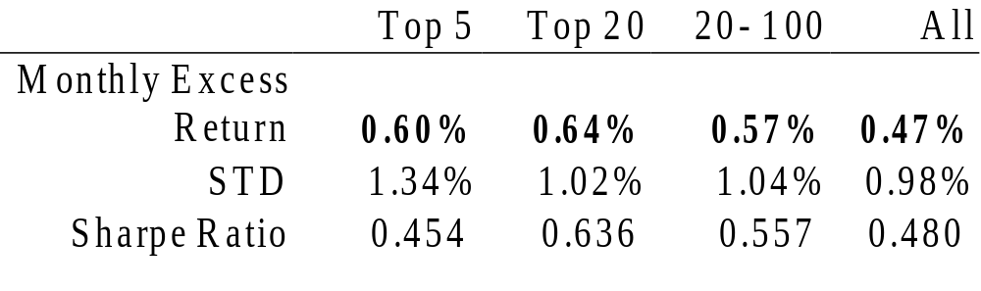
Monthly Next-Day Portfolio

Slide 20
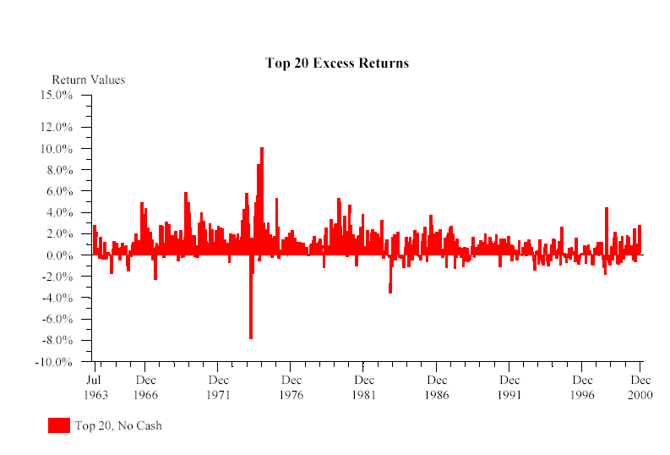
Monthly Performance

Slide 21
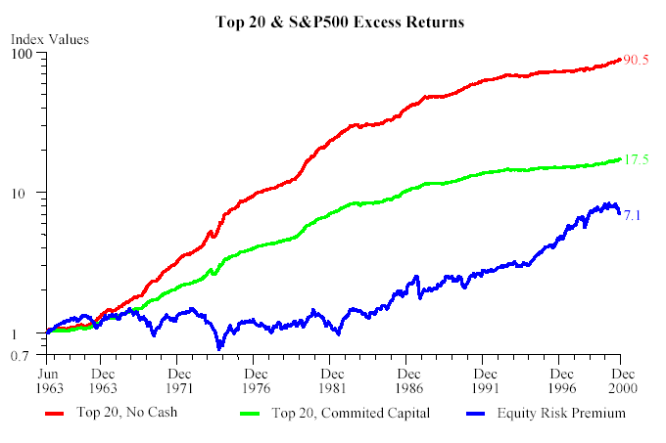
Cumulative Excess Returns

Slide 22
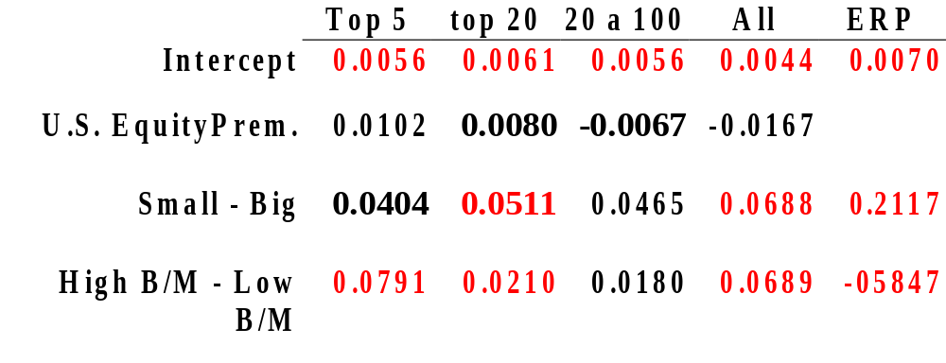
Systematic Risk Exposure

Slide 23
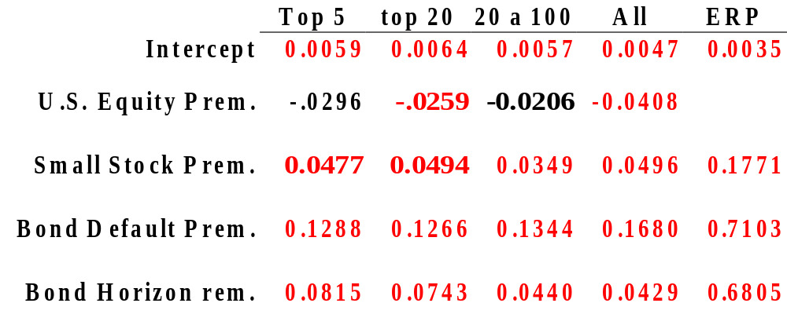
Ibbotson Risk Exposures

Slide 24
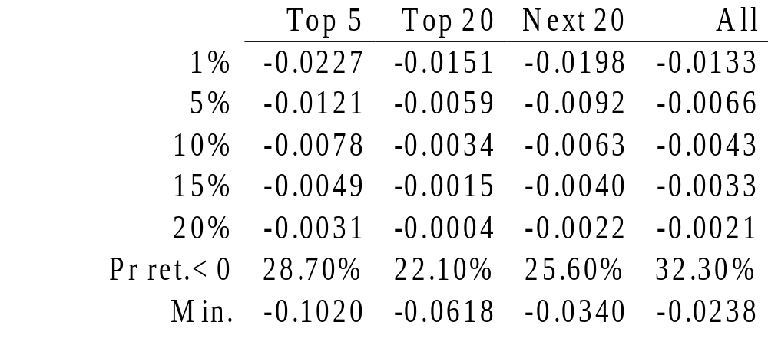
Monthly Value at Risk

Slide 25
Micro-Structure
Bid-Ask Bounce
  conditional upon an up move, price is likely an ask.
  conditional upon a down move, price is likely a bid.
J&T (1995) C&K (1998)
  Contrarian profits all bounce?

Slide 26
Controlling for Bid-Ask Bounce
Wait a day to open position
Wait a day to close position
Effect:
  Excess return drops by 240 BP

Slide 27
Transactions Costs
Conservative round-trip cost estimate
  Same Day vs. Wait 1 Day = 200 BP
  2.4 RT per pair/6 months
  83 BP/RT and an effective spread of 42 BP
Net 6 month excess return: 168 to 88 BP

Slide 28
Contrarian Profits?
Mean Reversion
  DeBondt and Thaler(1985,1987)
  LSV (1994)
  Lehman (1990), Jegadeesh (1990)
Test: If solely mean-reversion,
  Random pairs should be profitable.
  They are mostly not.

Slide 29
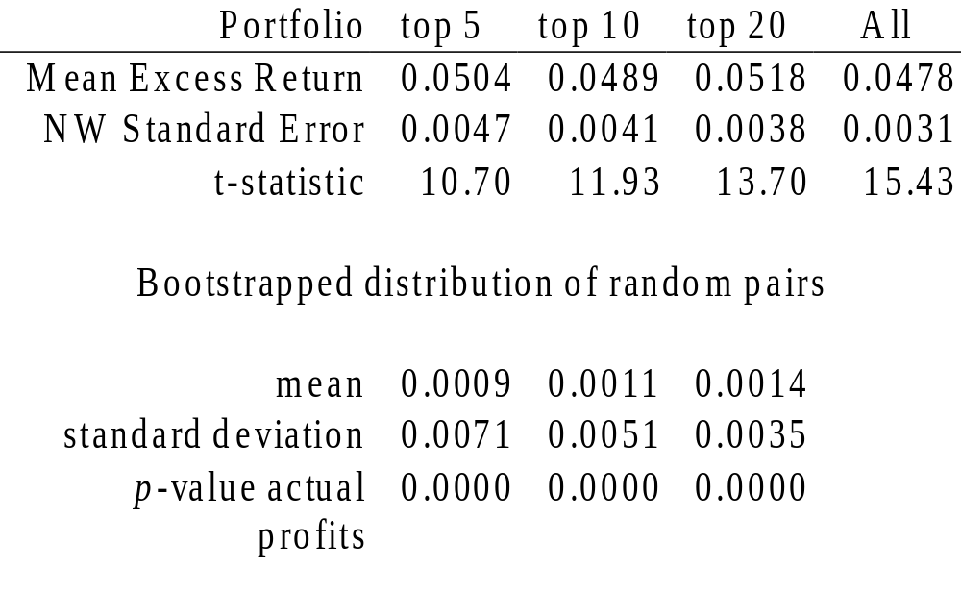
Bootstrap for Utilities

Slide 30
Improvements
We may be opening pairs too soon
We may not be picking pairs wisely
Other sensible rules
  don’t open a pair on the last day of the period

Slide 31
Implications
Document relative price reversion
Marginally profitable
  Consistent with hedge fund business
Not simply mean reversion

